Slide 1
Failure Modes in Heat Recovery Steam Generators (HRSGs)
LIYANAGE A.L.D.N.
SAMARATHUNGE S.M.T.N.

Slide 2
In this presentation we are going to discuss about the main HRSG failure mechanism influenced by cycle chemistry and thermal transient behaviors.
These findings are from available literature up to date.
According to our findings we can mainly divide these into 2 parts.
Cycle chemistry influenced failure mechanisms
FAC
UDC
Thermal transients influenced failures

Slide 3
Cycle chemistry influenced failure mechanisms

Slide 4
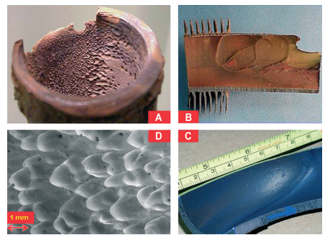
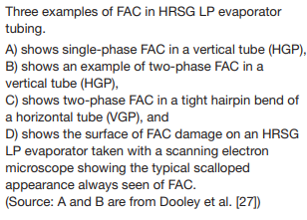
Flow-Accelerated Corrosion (FAC)
Occurs when the protective oxide layer (magnetite) on carbon steel dissolves due to water flow or wet steam, causing metal loss and thinning.
Where?
Single-Phase FAC:
Economizer/preheater tubes at inlet headers.
Vertical LP evaporator tubes near bends and outlet headers (HGP units).
IP evaporator tubes in triple-pressure units at reduced pressure.
Two-Phase FAC:
LP evaporator transition headers.
Horizontal LP evaporator tubes at tight hairpin bends (VGP units).
LP drum internals.
Deaerators and LP heater shells in conventional plants.
Notes:
Particularly in regions with high flow rates and turbulence.
FAC causes localized thinning, leading to failures at high-stress points such as near bends, high-turbulence areas and transition headers.
A- This is called Scalloping effect- FAC’s signature look; wave like depressions
Deaerator- used to remove dissolved gases, primarily oxygen and carbon dioxide, from the feedwater. These gases, if not removed, can cause severe corrosion in the boiler and the steam system.

Slide 5
Flow-Accelerated Corrosion (FAC)
Role of Feedwater Chemistry in FAC Control
Reducing All-Volatile Treatment (AVT(R)):
Uses ammonia and reducing agents.
Oxygen Level: < 10 µg/kg : Maintain low oxygen levels
ORP: –300 to –350 mV (optimal), can be as high as –80 to –100 mV.
Risk: Increased susceptibility to FAC under less controlled ORP.
Oxidizing All-Volatile Treatment (AVT(O)):
No reducing agents; relies on air in-leakage.
Oxygen Level: < 10 µg/kg at condensate pump discharge.
ORP: Around 0 mV, slightly positive or negative.
Benefit: Reduces FAC risk by minimizing reducing conditions.
Oxygenated Treatment (OT):
Adds oxygen and ammonia to feedwater.
ORP: +100 to +150 mV.
Benefit: Strong oxidation environment, highly effective in preventing FAC.
Notes:
Feedwater chemistry plays a important role in managing Flow-Accelerated Corrosion in HRSGs.
There are three main treatments: Reducing All-Volatile Treatment (AVT(R)), Oxidizing All-Volatile Treatment (AVT(O)), and Oxygenated Treatment (OT).
AVT(R) involves adding ammonia and reducing agents to maintain low oxygen levels, but this can increase FAC risk if ORP (Oxidation Reduction Potential) isn't tightly controlled. Reducing conditions (low oxygen levels – FAC high). In the other hand, High oxygen levels form Hematite (Fe2O3).
AVT(O) eliminates reducing agents, reducing FAC by keeping the ORP around neutral.
OT, which adds both oxygen and ammonia, creates a strong oxidizing environment, offering the best protection against FAC.

Slide 6
Under Deposit Corrosion (UDC)
Localized corrosion develops beneath deposits on a metal. These corrosion products are mostly formed due to FAC in the low temperature parts of the system.
There are 3 main UDC mechanisms.
Caustic Gouging
Acidic phosphate corrosion
Hydrogen Damage

Slide 7
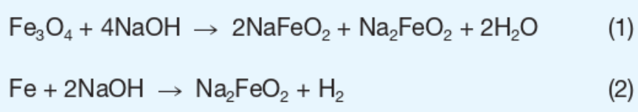
(i) Caustic Gouging
How?
Caustic gouging is a type of Under Deposit Corrosion in boiler and HRSG tubes, caused by excessive deposits of corrosion products and concentrated sodium hydroxide.
The concentrated sodium hydroxide dissolves (fluxes) the protective magnetite layer, Eq. (1), and/or the tube metal, Eq. (2). The products of these reactions are crystals of sodium ferroate and ferroite.
Where?
HP Evaporators: Due to sodium hydroxide concentration under thick deposits.
Tube Bends and Welds: Flow disruptions lead to deposit accumulation.
LP and HP Evaporator Tubes: When there’s internal flow disruptions.

Slide 8
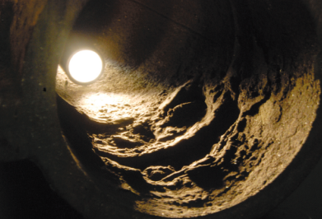
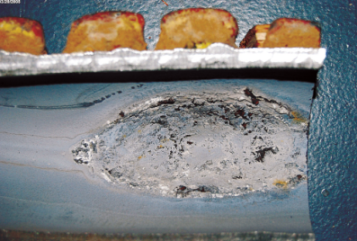
(i) Caustic Gouging
Features of failure | Gouged areas; thick, adherent deposits. Ductile, thin-edged or pinhole failure. Longitudinal cracks are the typical appearance in HP evaporators of HRSGs since any bulging is restricted by the fins.
Key microstructural features | Material removal only, no microstructural changes in the tube material. No protective magnetite layer.
Attack rate | Rapid (up to 2 mm per year).
Heavy deposits and caustic gouging
Closeup view of gouge
Notes:
The physical manifestation of caustic gouging is characterized by gouged areas with thick, adherent deposits. These deposits lead to localized thinning of the tube material, which can result in ductile, thin-edged, or pinhole failures. Longitudinal cracks may also appear in high-pressure evaporators due to the restriction caused by fins, preventing bulging.
One of the key factors contributing to caustic gouging is the presence of heavy deposits caused by inadequate water treatment, specifically, excessive levels of sodium hydroxide. The rapid attack rate of up to 2 mm per year highlights the severity of this issue.
From a microstructural perspective, caustic gouging leads to material removal without significant microstructural changes in the tube material. However, the absence of a protective magnetite layer is a hallmark of this failure mode.
To prevent caustic gouging, it's crucial to maintain appropriate levels of sodium hydroxide and ensure effective monitoring of boiler water chemistry. Regular inspections and timely chemical cleaning are essential to remove deposits and mitigate the risk of tube failures caused by caustic gouging.

Slide 9
(i) Caustic Gouging
Root causes?
Poor feedwater treatment: Results in high levels of corrosion products (iron and copper oxides) which can deposit in HRSG tubes.
High concentration of sodium hydroxide in boiler water due to:
Excessive sodium hydroxide under sodium hydroxide treatment.
Overuse of sodium hydroxide during all-volatile treatment (e.g.,startup or overcoming acidic contamination).
High sodium hydroxide levels used as a pH control under phosphate treatment.
Flow disruptions: In the internal water flow inside HRSG HP evaporators, contributing to increased deposition of corrosion products.
Undetected/excessive deposits: Due to inadequate tube sampling or delayed chemical cleaning.
Ineffective chemical cleaning: Deposits remain in critical areas of HRSGs.
Ingress of sodium hydroxide: Due to issues in makeup water treatment units or condensate polishers.

Slide 10
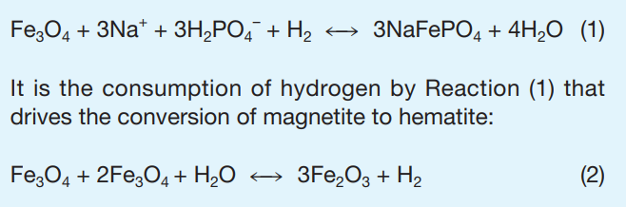
(ii) Acidic phosphate corrosion
How?
In high temperatures and pressures (>100 bars) phosphate hideout can occur and it will cause a sudden decrease in phosphate concentration in the feed-water. Excess phosphate will be deposited as Sodium iron hydroxy phosphate – SIHP.
SIHP is unstable at ambient water conditions, thus it re-dissolves when water is cooling (phosphate hideout return). This will decrease Na to phosphate ratio.
Na to phosphate drops below 3, feed-water will become acidic.it will react with the oxide layer and create NaFePO₄ and Fe₂O₃.
This reaction convert Magnetite layer into hematite rapidly and cause severe corrosion.
From PPChem, 2010

Slide 11
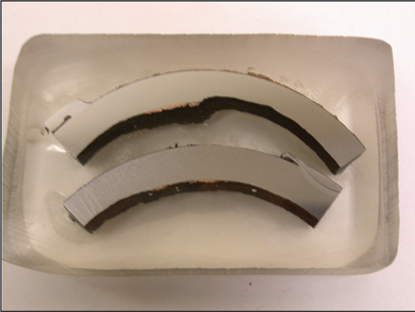
(ii) Acidic phosphate corrosion
Where?
HP evaporator tubes and headers.
Root causes
Formation of deposits
Phosphate hideout
Phosphate hideout return
Flow disruptions
Identification
Tube thinning can be identified using ultrasonic testing.
Acidic phosphate corrosion gouge

Slide 12
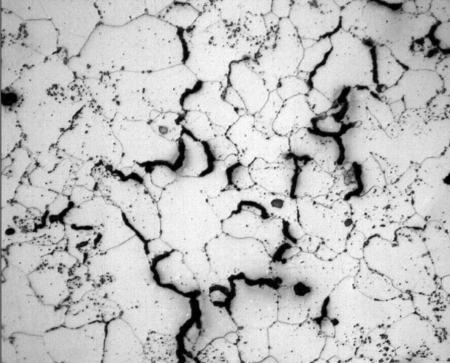
(iii) Hydrogen Damage
Condensation of chlorides under the deposits create local acidic environment. This will generate atomic hydrogen and defuse into perlite structure.
These atomic hydrogen will react with cementite in pearlite structure and micro-cracks will be generated. This will lower the strength of the carbon steel and lead premature ruptures in the pipes.
Chloride irons can enter the cycle through minor condenser leakages.
Where?
HP evaporator tubes
Identification
Some times tube thinning does not occur. Harder to identify using NDE methods.
Micro-fractures in pearlite structure

Slide 13
Thermal transients influenced failures

Slide 14
What are thermal transients?
They are the repeated heating and cooling cycles happens during plant’s startup, shutdown and load changes.
How they cause failures?
This thermal transients cause thermal stresses in the components due to restricted expansions and temperature gradients.
Transients cause irreversible fatigue damage in components during each thermal cycle.
After a number of repeated cycles, small cracks will form in the stress concentrations and eventually they lead to thermal fatigue failures and corrosion fatigue failures.
How to identify?
Through plant’s distributed control system(DCS) trends.

Slide 15
Commonly identified causes for damaging thermal transients
Attemperator spray water leakages.
Attemperator overspray.
Ineffective HP SH draining during startup.
High pressure ramp rates in HP and LP drums.
HP bypass control valve erosion.
Forced cooling

Slide 16
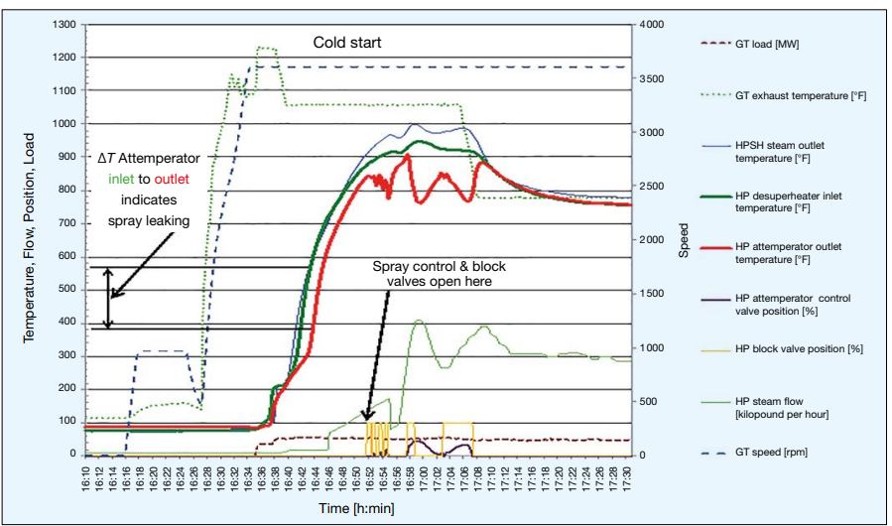

Attemperator spray water leakages
When the HP SH outlet has zero or low steam flow and attemperator water leakage is present in the system. Spray water will accumulate at the bottom of the pipes.
Small leakages cause no problem. But better to be aware of this.
Possible failures:
Cracks in girth welds
Hogging of the pipe due to top and bottom temperature difference of the pipe.
Main cause:
Master control/Martyr block valve logic
Identified by looking at the $ΔT$ between attemperator inlet and outlet during early startup.
From PPChem, 2019

Slide 17
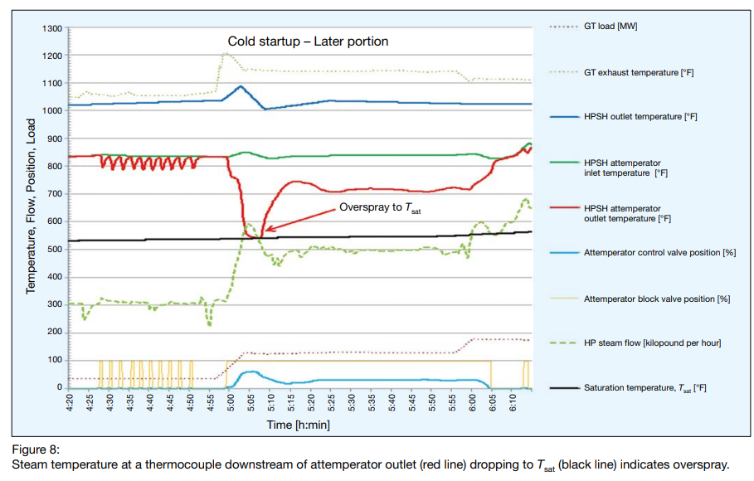
Attemperator overspray
When steam flow rate and temperature is not sufficient enough to evaporate the sprayed amount of water. The water droplets will accelerate and hit the pipe inner surface and can cause erosion.
Identification
If the temperature downstream the attemperator drops to sat. temp it indicates an overspray
Root causes:
Issues in attemperator control system.
Manual operation of the spray valve.
Lack of attemperator protective logic

Slide 18
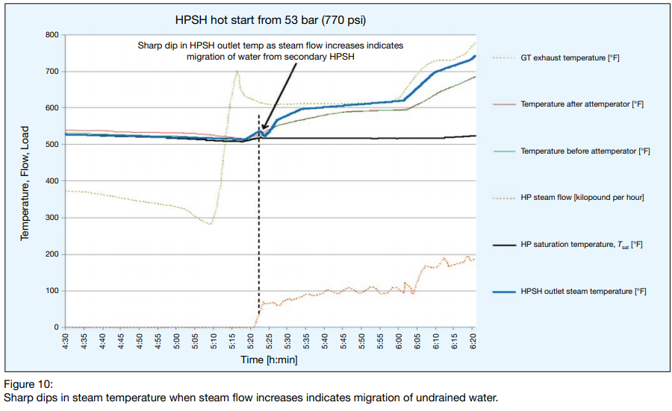
Ineffective HP SH draining during startup
Migration of undrained condensate throught pipes cause damage to steam pipes, headers and tubes.
Large amount of condensate will generated inside the SH tubes during CC purge, prior to the start up. It has to be drained properly before initiate the steamflow.
Identification
Cannot identify directly. Condensate migration can be identified by looking at HP outlet temperature.
Causes:
Small drain valves
Small slope of the drain pipes
Blowdown tank location
Control valve operation
NEM has mentioned that in our plant this draining procedure happens automatically during start up.
They have also mentioned drains have sized for the cold most HRSG start up.

Slide 19
HP drum damages due to high pressure ramp rates
If the drum pressure ramp rate exceeds the maximum ramp rate given by the manufacturers it will cause cracks in the magnetite layer. This can lead to corrosion fatigue failures.
Depressurizing ramp rate is lower than the pressurizing ramp rates
NEM has noted depressurizing ramp rates as,
HP drum ramp rate = -3 bar/min
LP drum ramp rate = -0.15 bar/min
Where?
Drum to shell down-comer welds
Drum nozzles
Identification
These can be identified by looking at the DCS plots/trends related to drum pressures.

Slide 20
Forced cooling
Some manufactures cool down HRSGs rapidly before conduct maintenance work.
This include venting steam through the HP drum vent, HP bypass system.
This cause overly aggressive ramp rates in HP drum.
Identification:
Can be identified through DSC trends.
HP bypass pressure control valve erosion
Erosion in bypass valves due to passing wet steam through PCV.

Slide 21
References
Europeanhrsgforum.com. (2019). Technical Documents. [online] Available at: https://europeanhrsgforum.com/technical-documents/.
Dooley, R. and Bursik, A. (2010). PPChem 101 -Boiler and HRSG Tube Failures 122 PowerPlant Chemistry. [online] (2), p.12. Available at: http://competitivepower.us/pub/pdfs/hydrogen-damage.pdf.
Dooley, R. and Anderson, B. (n.d.). Assessments of HRSGs - Trends in Cycle Chem & Thermal Transient Performance. POWERPLANT CHEMISTRY 2009.
Dooley, R.B. and Chexal, V.K. (2000). Flow-accelerated corrosion of pressure vessels in fossil plants. International Journal of Pressure Vessels and Piping, 77(2-3), pp.85–90. doi: https://doi.org/10.1016/s0308-0161(99)00087-3 .
Dooley, R. and Bursik, A. (2010). BOILER AND HRSG TUBE FAILURES PPChem 1 1 0 0 1 1 Caustic Gouging. PowerPlant Chemistry, [online] (3), p.12. Available at: http://competitivepower.us/pub/pdfs/caustic-gouging.pdf .
Dooley, B. and Anderson, R. (n.d.). SPECIAL REPORT - HRSG Assessments Identify Trends in Cycle Chemistry, Thermal Transient Performance. COMBINED CYCLE JOURNAL 91Q-115-131.

Slide 22
THANK YOU!

